Slide 1
Haynes 282® vs Waspaloy®: Comparison of Ni-Based Superalloys for Use in Turbine Engines
Sponsor: Technetics
Team members: Alex Yang, Anna Harris, Carter Grabbe, Christine Brockman, Colter Smith, Connor McGettigan
4-30-2020
Notes:
Colter

Slide 2
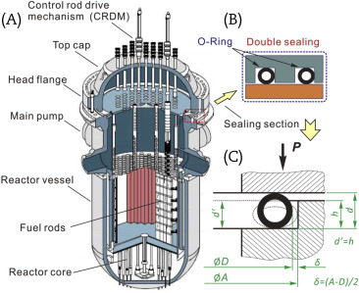
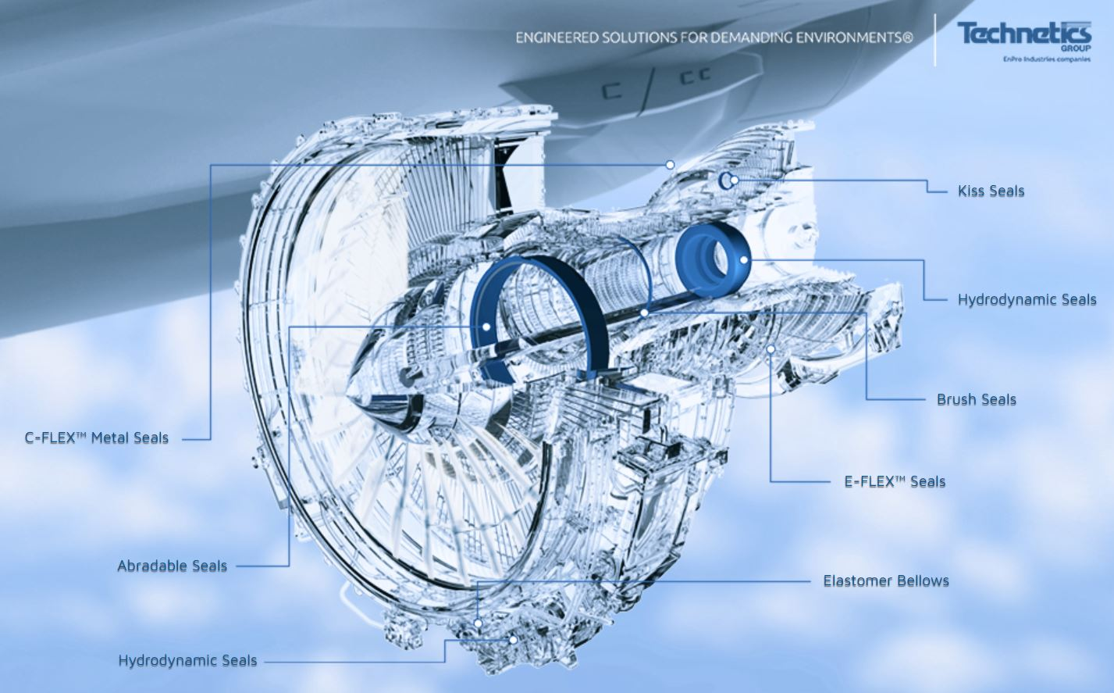
Notes:
We are investigating two different materials for use in metallic seals. These seals are used in high temperature and high stress environments. This includes nuclear pressure vessels and aerospace turbine engines which is the main focus of our project. These image show the location of the seals in these applications. A seal failure could have devastating effects and in both situations this could put human lives in danger.

Slide 3
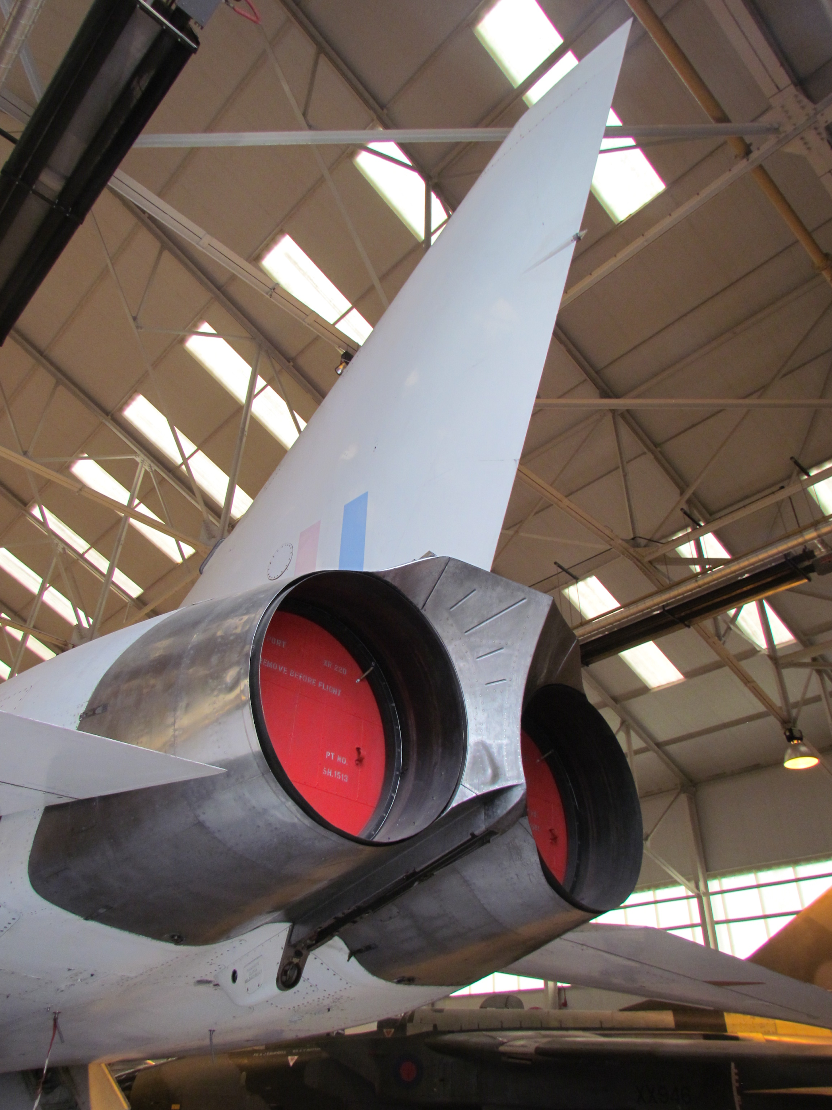

Sponsor contacts:
Jonathan Kweder – R&D Engineering Manager
Ryan Plessinger – Metallurgical Research Engineer
Notes:
Technetics group is a producer of engineered industrial products for the processing and general manufacturing industries. They specialize in industrial seals and components for use in extreme applications such as aerospace and nuclear power. Our contacts within Technetics for this project were Dr. Jonathan Kweder and Ryan Plessinger.

Slide 4


Design Objective
Waspaloy vs Haynes 282
Notes:
Script: Our objective is to compare the properties of Haynes 282 and Waspaloy for use in aero turbine engine seals. Before the closure of campus facilities, we set out to accomplish this via the design and implementation of a test plan that would produce actionable, distinguishing data meant to closely reflect the environmental conditions to which these seals are subjected. After the closure of campus and thus testing facilities, we opted to leverage our access to literature to create a case study on the two materials.
Ultimately, we’ve produced a refined test plan as well as a series of recommendations regarding the relative strengths of each alloy and how best to further investigate them based on experimentation and literature review.

Slide 5
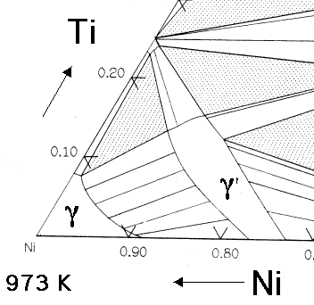

Ni-based Superalloys
Notes:
The nickel-based superalloy is conventionally wrought processed, and usually contains significant amounts of up to 10 alloying elements. It is strengthened mainly by gamma prime precipitation from the addition of alloying elements. The image on the right shows a formed gamma prime precipitate microstructure for the strengthening. Ni-based superalloys usually process good corrosion resistance and high temperature stability.

Slide 6

Sponsor Motivation
1952
2005
Now
Future
Industry standard
Waspaloy
Haynes 282
Replacement
Notes:
Waspaloy is a Ni-based superalloy currently used in aero-based gas turbine engines that was developed in 1952 and has been the industry standard. Although Waspaloy has good strength properties and corrosion resistance at high temperature, Haynes 282, are being investigated since 2005 to replace the existing Waspaloy alloy as it has better properties of creep strength, thermal stability, weldability, and fabricability not found in currently available commercial alloys. Technetics realizes that the potential of employing Haynes 282 as a supplement to Waspaloy may be a good strategy to improve products. However, the higher temperature properties for the new material are not fully understood. The company believes that starting the investigation will have a strong impact in the industry.

Slide 7

User Needs
Material Needs: Comparison of Waspaloy and Haynes 282
Process Design: Test Plan
Testing Need: Efficient test plan (limited resources, maximum properties)
Notes:
Our project is not a product, but a process, and we are its users, along with anyone else that may use our test plan in the future. As such, our needs fall into two categories: material needs and testing needs. Our primary material need is to determine whether Haynes 282 is actually an improvement over Waspaloy in terms of high temperature mechanical properties. To do this, we need to simulate the interior conditions of an aircraft engine and measure performance. From there we would need to establish a comparison between Waspaloy and Haynes 282 based on the testing results and literature reviews. Which brings us to our second class of user need: testing. We are working with limited time, samples, money, and access to equipment. Generating significant data is incredibly important, but with these constraints, so is efficiency. We need to maximize the number of properties tested while minimizing the number of tests we conduct and thus the resources we consume while doing them.

Slide 8



Ethical and Environmental Considerations
Notes:
When technetics received the initial data about Haynes 282 from Haynes they decided to do the ethical thing and carry out their own tests. They are the ones making and selling the seals so they wanted to completely vet their products and make sure they perform as advertised. The NSPE code of ethics states that engineers must “hold paramount the safety, health, and welfare of the public”. Knowing that their seals are used in potentially dangerous applications, Technetics is following that code by getting every piece of information they can to verify the performance of their products. As far as the environmental considerations go, any application these seals are used for has the potential for pollution like the oil and gas and aerospace industries. Any seal that is stronger, lighter, and more trustworthy in their resistance to failure will be the better option to limit the environmental impact.

Slide 9
Recommended Test Plan
Test | Machine | Values Produced | # of samples | Different Temperatures
Uniaxial tensile test (stress-strain) | High-temp uniaxial tensile tester | Resiliency UTS Modulus | 15 | Room temperature, 800, 1000, 1200, 1400 °F
Stress-Rupture | Creep Test Systems | Time to failure | 1+ | 1400 °F
Low cycle fatigue strength | Servohydraulic Test Systems | Fatigue ductility constants | 12 | 800, 1000, 1200, 1400 °F
Thermomechanical fatigue | Servohydraulic Test Systems | Material constants | 12 | 800, 1000, 1200, 1400 °F
Notes:
Script:
Our test plan is designed to target usable, discriminating data. We’ve recommended tests that can closely emulate the extreme conditions to which these seals are exposed. For example, a thermomechanical fatigue test subjects a specimen to some combination of cyclically varying heat and strain. The test parameters can be tuned to match the cyclic heating and cooling of the plane’s engine, and temperatures to those experienced by the seals.
In addition, our test plan was altered to incorporate considerations made during the literature review. We found that low cycle fatigue testing, while not as specifically accurate to the seals working condition as thermomechanical fatigue, is considered a standard reference test for many structural alloys in the aerospace industry.

Slide 10

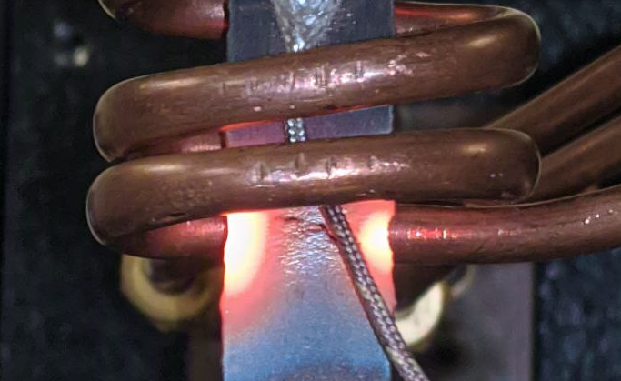
Challenges & Recommendations
Notes:
Edge roughness, stress intensification
Heat localization, develop processes to reduce heat buildup/cycling which is intensified in sheet metal geometry
Script: During the initial testing completed before the closure of campus facilities, we encountered a series of challenges that we attribute primarily to inadequate sample preparation and local effects created by the thin geometry of the samples. Note that our testing was scheduled to begin shortly before shutdown, so we couldn’t employ our own solutions to these problems, and we’re presenting them as considerations to go along with our test plan.
We used the Inventions Studio’s waterjet to cut our dogbone samples and came away with some very rough edges. We noticed many cracks initiated at those points of roughness, suggesting that they acted as sites of stress intensification. We also observed cyclic, red-hot bands forming close the induction heater during high-temperature testing, causing unaccounted for thermal cycling. We believe this to be a product of the thin sample geometry and on-off heating of the induction coil.

Slide 11
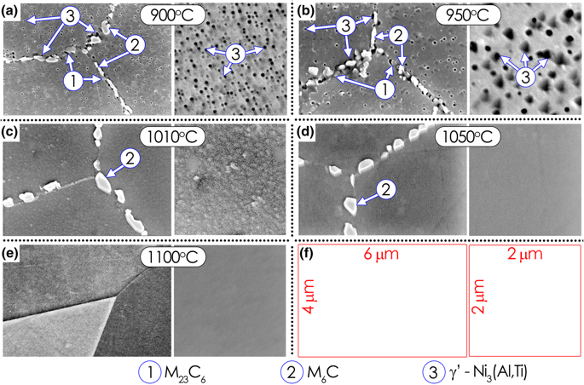
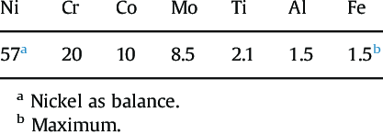
Haynes 282 Composition
Notes:
Under the COVID-19 situation, we switched the design focus to be based on the literature reviews. For Haynes 282, a typical composition contains Cr, Molybdenum and Co in considerable fraction with balanced Ni, and it contains other alloying elements such as Ti, Al, and Fe... Ti and Al alloying elements are important for the strengthening effect related to the formation of different phases, including γʹ, Cr based metal carbides of (M6C, M23C6), and newly identified boron-based carbides phases. and their appearance in the microstructure gives rise to the stability of the strength, ductility and other properties at elevated temperatures. A balance of alloying element of Al and Ti is crucial in order to maintain a low gamma/gamma prime misfit for optimal creep performance.

Slide 12
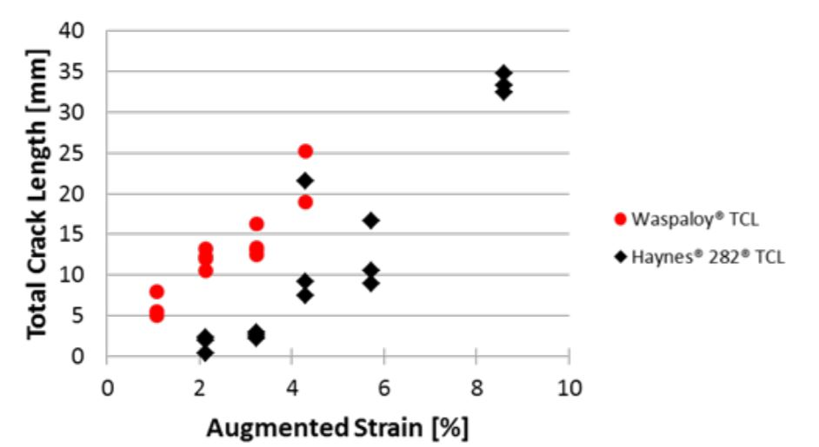
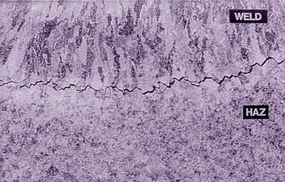
Better Hot Ductility & Weldability for Haynes 282
Notes:
Haynes 282 processes a better hot ductility. It is rare that the fusion zone cracking is not seen in Haynes 282 while it is a common effect on other gamma prime precipitate hardening superalloys. H282 has a good recovering ductility. Surprisingly, the changes of the heating conditions do not affect the recovering hot ductility much.
Thus, H282 has good weldability than other gamma prime precipitates materials. While in other Ni-based superalloys, liquation formation during welding would lead to hot affected zone cracking, the precipitates on GB in H282 reduces the liquation and results in fewer cracks and slower crack growth, which largely improves its weldability compared to Waspaloy as shown in the figure on the right.

Slide 13
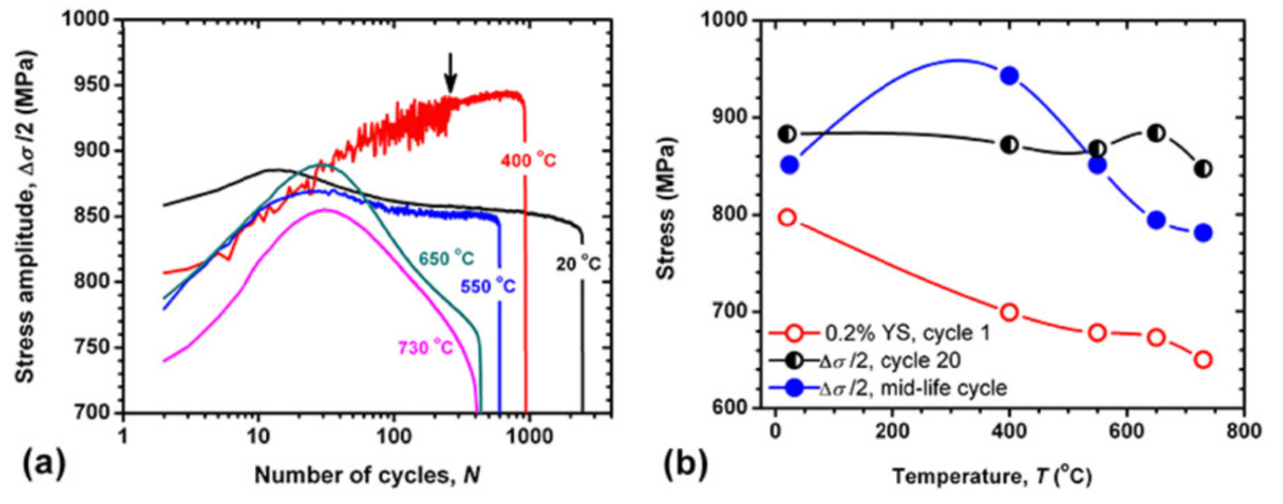
LCF and DSA of Haynes 282
Low Cycle Fatigue testing shows evidence of cyclic hardening and softening
Dynamic Strain Aging exhibits a temperature dependance
Notes:
Low Cycle Fatigue
For those of you not familiar, LCF uses cyclic plastic deformation of a given material to model the initiation of cracks and their growth over a small number of cycles
Low cycle fatigue behavior is often the primary consideration for industrial applications, as it is induced by thermal and mechanical cycling during the service life of the component
Numerous groups have demonstrated cyclic hardening in all tests within the first few cycles of straining, followed by subsequent cyclic softening for the remaining life of the material
Hardening and Softening is typical for NiBSAs, similar to Nimonic 80A
Dynamic Strain Aging
Present in H282, phenomenon that occurs during cyclic loading. It typically leads to increased stress and reduced ductility during monotonic loading, and during cyclic loading it leads to increased cyclic hardening, reduced plastic strain amplitudes, and decreased fatigue life.
Dynamic strain aging is the result of the locking and unlocking of dislocations by solute atoms during cyclic loading.
DSA dominated the development of stress during cycling of Haynes 282 at intermediate temperatures, which lead to extensive cyclic hardening and serrated yielding. Largest impact at 400C/ 752F, still significant at 550C/1022F
Similar behaviors observed in Waspaloy.

Slide 14
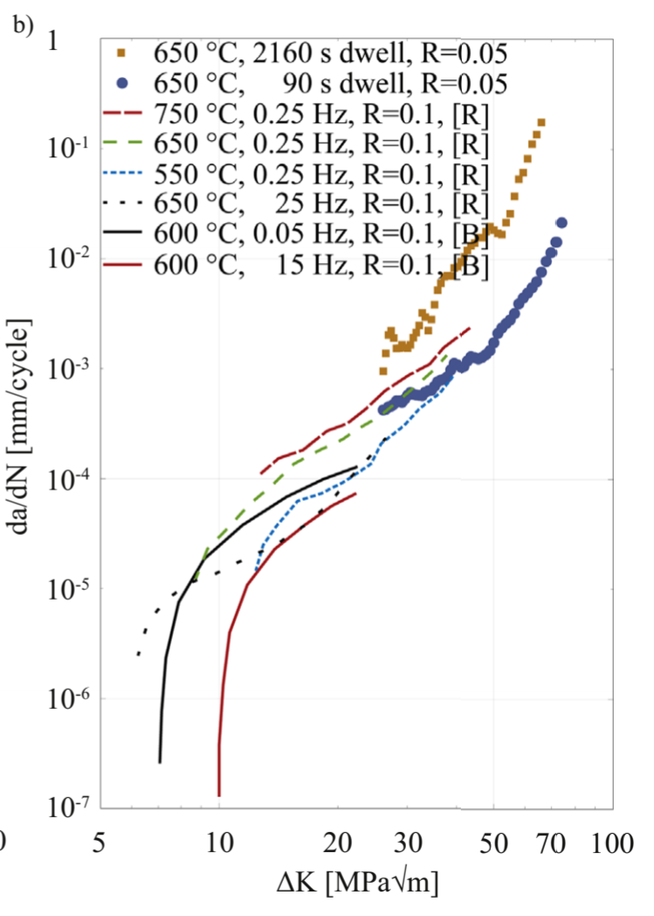
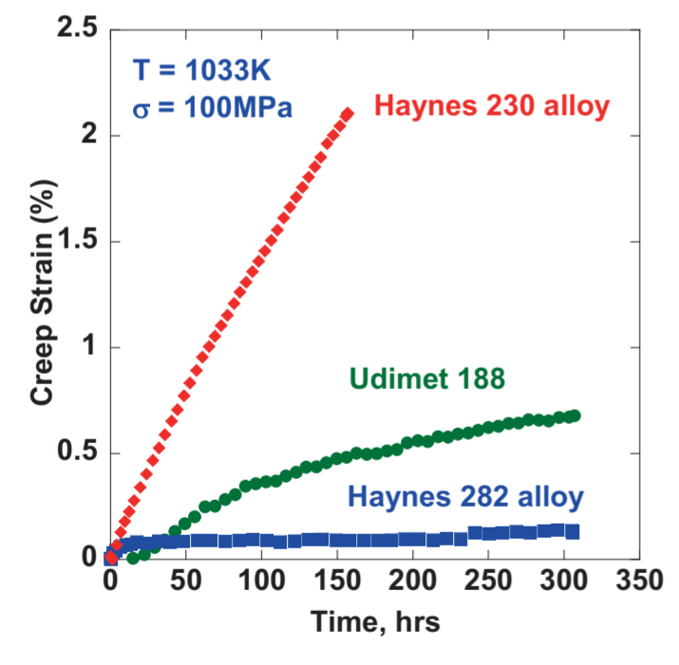
FCGR and Creep of Haynes 282
Rate of Fatigue Crack Growth is dependent on Temperature, Stress Ratio and Frequency
Haynes 282 shows strong creep resistance.
Notes:
Fatigue Crack Growth Rate
Fatigue life can be divided into an initiation period and a crack growth period. Unfortunately, the existence of pre-existing flaws or sharp design features can substantially decrease or even remove the required time for the crack initiation portion of fatigue growth from a component [7].
Therefore, while it is important to understand the LCF behavior of a material, one must also understand the rate of fatigue crack growth (FCG). This allows for the determination of the useful life of a component in service given manufacturing defects
Dependent on Temp (increase temp = increase FCGR), stress ratio (larger ratio = increase FCGR) and frequency.
Bit of controversy with rate of FCG, two papers (Buckson and Rozman) say frequency impacts FCG, one (Saarimäki) says it does not. Due to that, the literature is unclear and further testing is required.
Creep
Creep is a time-dependent phenomenon resulting from exposure to elevated temperature and constant stress
Testing demonstrated that the Haynes 282 alloy exhibited significantly lower creep strains and strain rates compared to Haynes 230
TMP Treatments
Strain recrystallization thermomechanical processing was ineffective at increasing grain boundary character for improved performance, not recommended for Haynes 282. Increased creep rate due to reduction in grain sizes

Slide 15
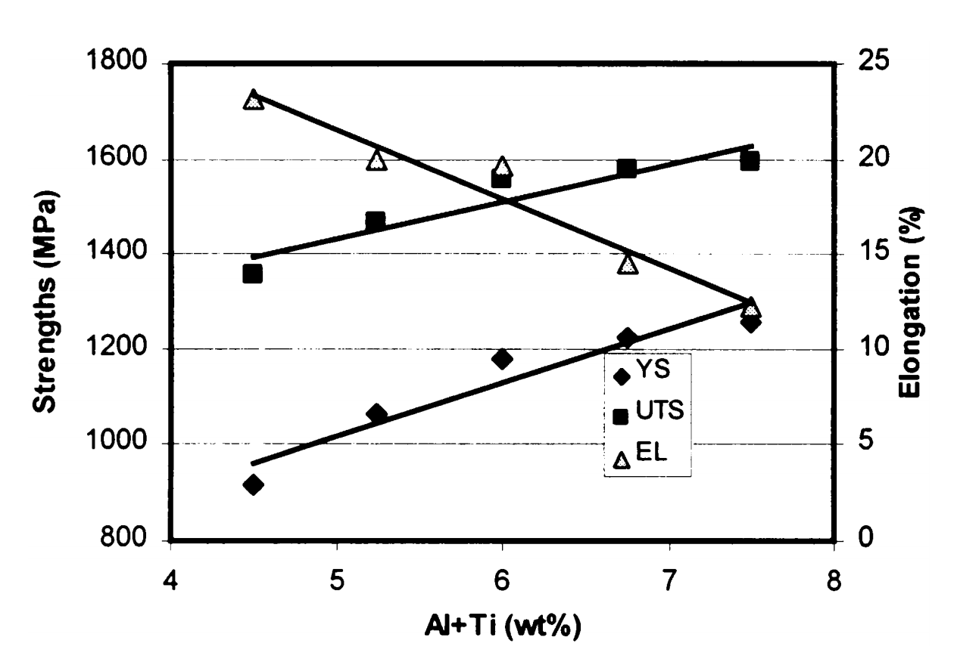
Waspaloy Composition
Composition of Waspaloy
Element | Wt %
Nickel (balance) | 54.00
Chromium | 19.50
Cobalt | 13.50
Molybdenum | 4.25
Titanium | 3.00
Aluminum | 1.40
Zirconium | 0.06
Effect of Al + Ti content on yield strength, UTS, and % elongation of Waspaloy
Notes:
We also conducted a literature review of Waspaloy, to investigate its properties and high temperature behavior. Its composition has some similarities to H282, and the main alloying elements of a typical composition are shown in the Table. Mo, Co, and Cr provide solid solution strengthening within the alloy while Al and Ti allow for age hardening, providing Waspaloy’s high temperature strength. Waspaloy has an intentional Zr addition, which provides grain boundary strengthening. Similar to what Alex discussed with H282, in Waspaloy, Al + Ti are important for gamma prime phase precipitation, which provides major strengthening mechanisms to the alloy. There was a study conducted to investigate the effect of Al and Ti content on the strength of the alloy, which indicated that both yield strength and UTS increased with increasing Al + Ti content in the alloy. This can be seen on the graph. However, with increasing Al + Ti content, elongation was found to decrease.

Slide 16
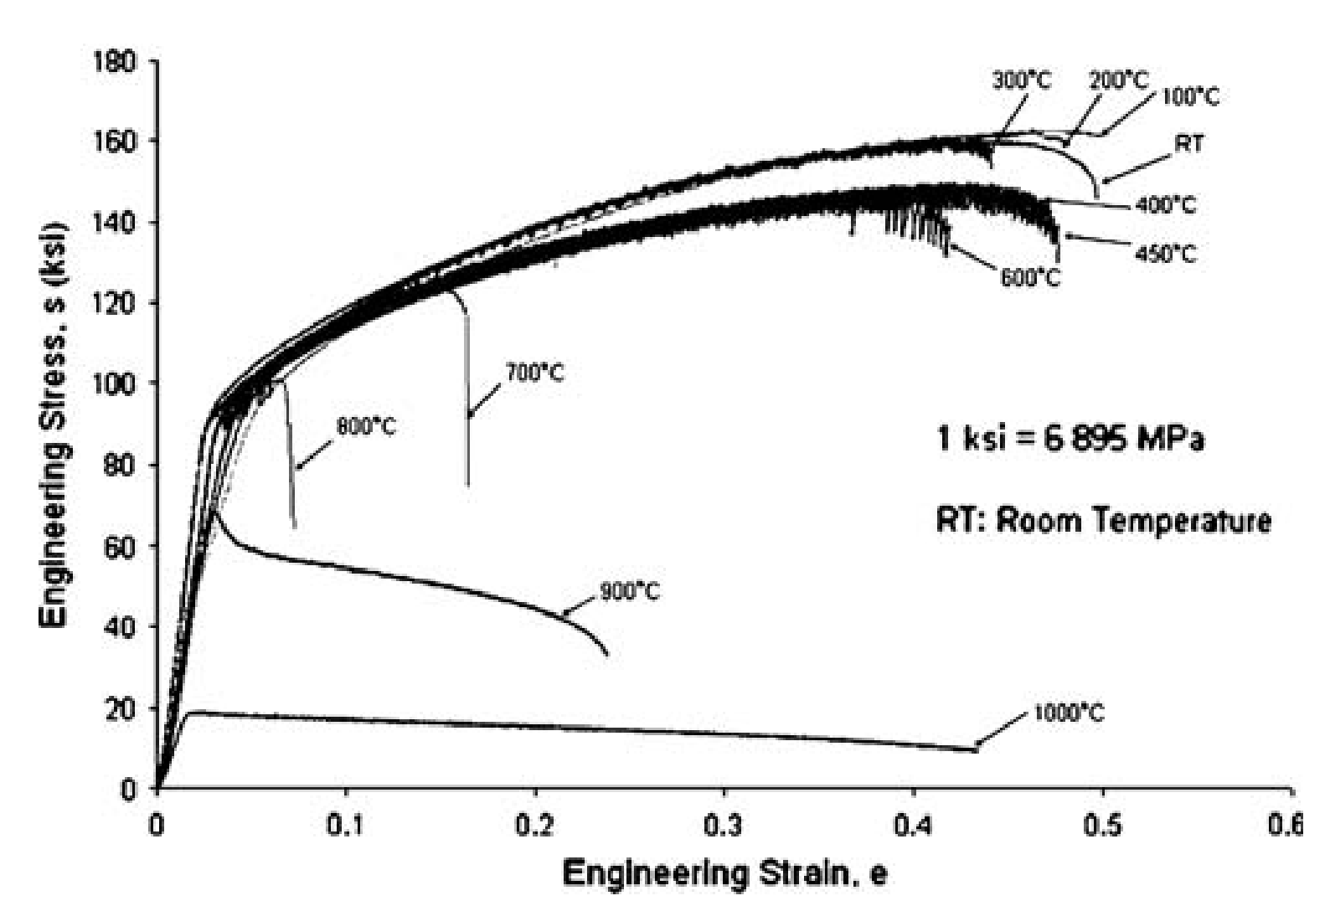
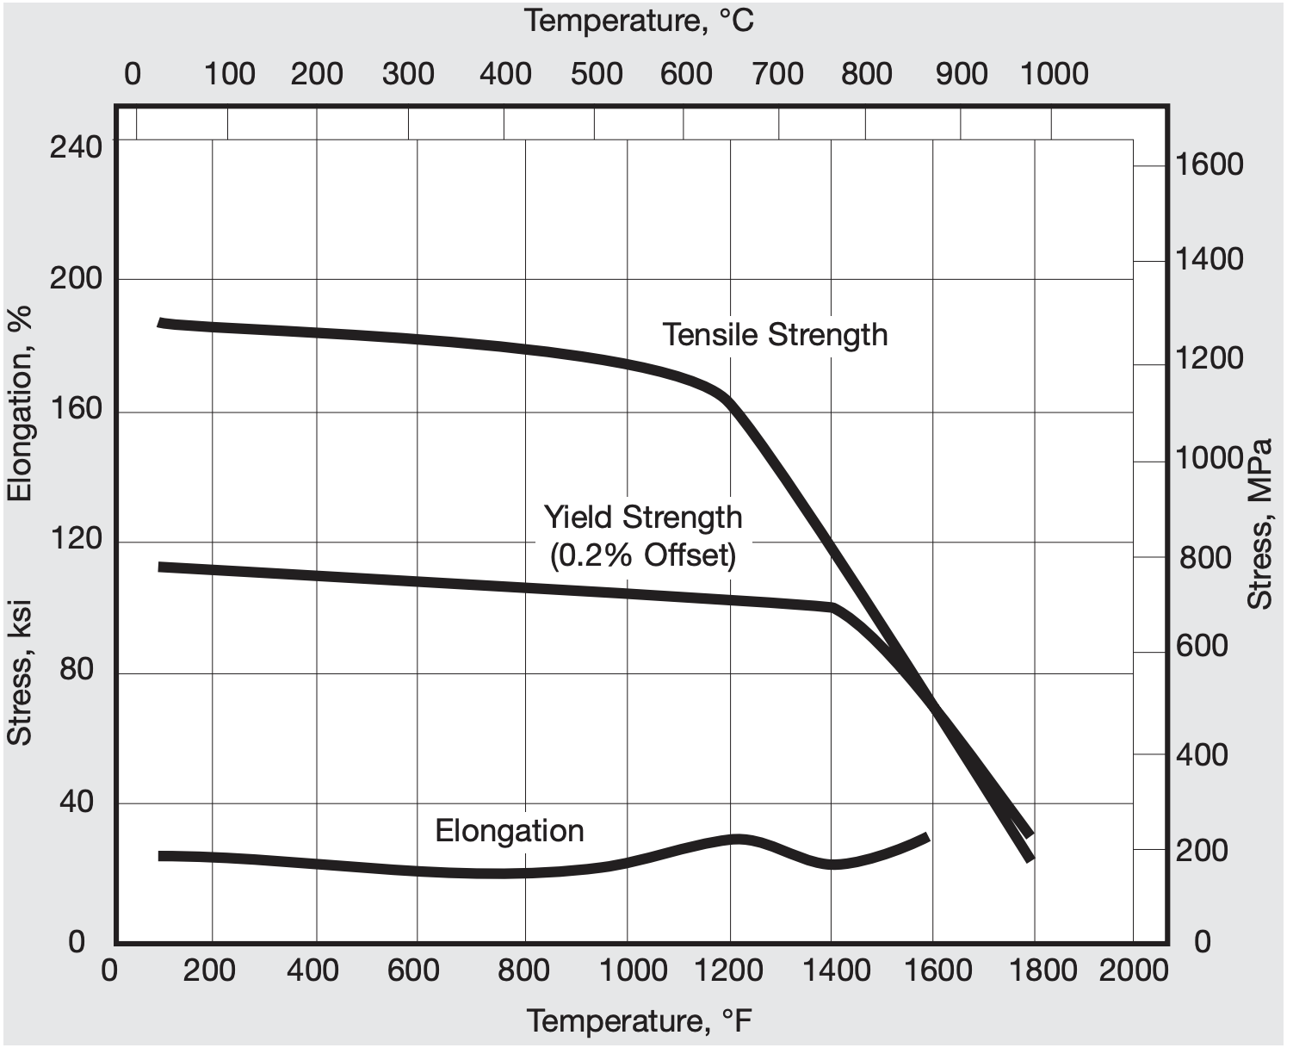
Tensile Behavior of Waspaloy
Yield strength and UTS significantly reduce with increasing temperatures
DSA at certain temperatures
Notes:
When compared directly to H282, Waspaloy actually demonstrates better tensile properties at ambient temperatures. However, as can be seen in the figure on the left, magnitudes of yield strength, and UTS begin to significantly decrease with increasing temperatures. The graph on the right shows a stress-strain curve produced by a study that investigated the tensile behavior of Waspaloy at several temperatures, ranging from ambient to 1000C. This graph shows nearly consistent tensile behavior until about 600C, where properties begin to significantly fall off. Studies have also found that at temperatures above 800C (1472F), no distinction can be made between yield strength and UTS, which indicates that there is no uniform strain at these significantly higher temps. Testing by many groups also indicate the presence of dynamic strain aging in Waspaloy at certain temperatures, specifically between 300-600C (572-1112F). DSA is attributed to solute diffusion.

Slide 17
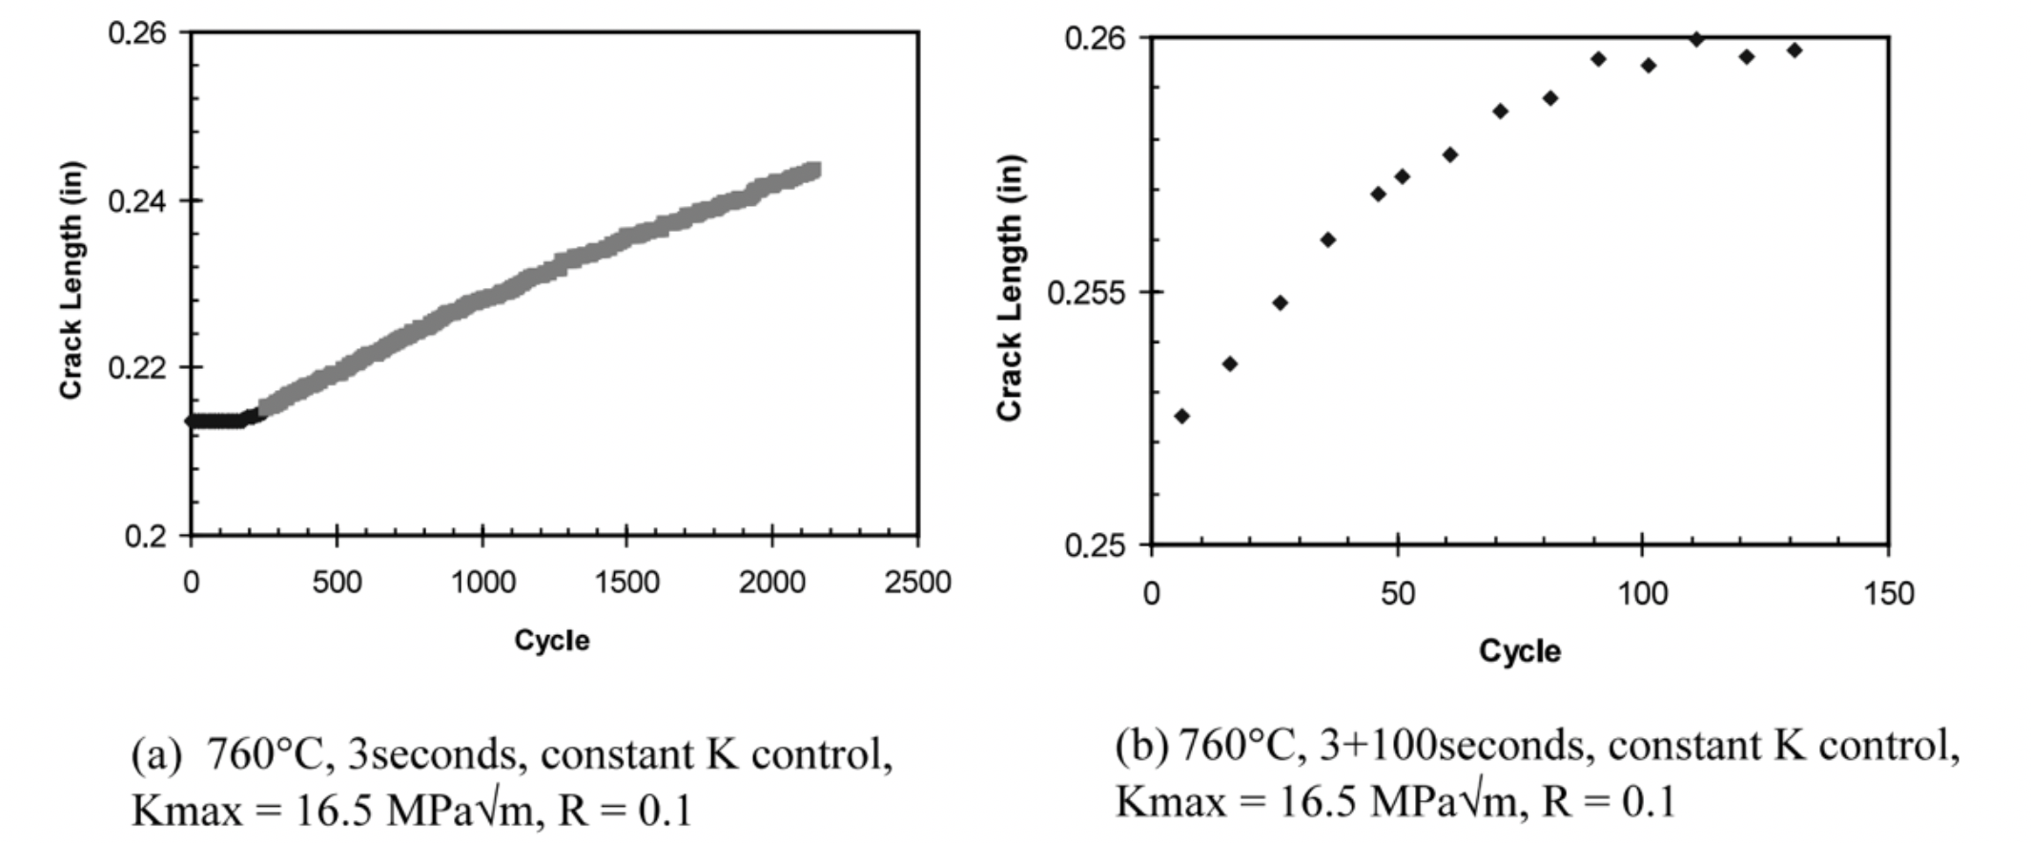
LCF and FCGR of Waspaloy
Significant decrease in LCF performance at elevated temperatures
FCG rates dependent on temperature, stage of crack growth, and creep damage
Notes:
When it comes to low cycle fatigue behavior, Waspaloy can withstand high strain values under fatigue conditions at ambient temperatures. However, there is a significant decrease in LCF performance at elevated temperatures, regardless of heat treatment.
Fatigue crack growth rates in Waspaloy become faster at higher temperatures. The two graphs, which show crack length vs cycle number, are from a study that investigated Waspaloy crack growth rates with hold time (left graph) and without hold time (right graph). These rates were found to generally increase with hold time. However, as the cycle number increased, this effect began to depend on the stage of fatigue crack growth, temperature range, as well as the competition between beneficial stress relaxation effect and harmful creep damage, making this effect slightly more complex.

Slide 18
Recommendations: Testing
Notes:
Issues resulted from the sample size and preparation methods. Fix with precise machining and thicker samples
Script: So, as Connor mentioned, issues resulted from the both imprecise machining of our samples and their initial geometry. For future iterations of our testing procedure, when machining samples using abrasive waterjet cutting, parameters should be set for around half a kg per minute and half a megapascal of pressure. Polishing and etching could be employed as well. In addition, we recommend thicker samples on the order of fractions of inches as opposed to thousandths of inches. This should prevent the uneven heating and loss of heat that we experienced, both of which lead to low-quality data for high temperature measurements.

Slide 19
Recommendations: Economics of Haynes 282 vs Waspaloy
Notes:
In terms of economics, Haynes appears to be the superior alloy. It is cheaper, its composition suggests good fabricability, and in a direct test of weldability, it outperformed Waspaloy by a significant margin. All of this is to say that, when working with Haynes, not only will the material itself be cheaper, but if it’s easier to form and join, there will be fewer defective parts made, meaning less material needs to be scrapped, and thus the job itself will be cheaper. Technetics has already mentioned to us that the difficulty of working with some alloys lies in the number of defective parts that they generate, so this would make Haynes a significant improvement

Slide 20
Recommendations: Performance
Notes:
Regarding their performance during service, it was difficult to draw meaningful conclusions from our literature review. The fact of the matter is that there is precious little data directly comparing Haynes 282 and Waspaloy, and this wouldn’t be a project worth pursuing if that data was easy to find. But what we CAN say conclusively is this: both alloys exhibit the dynamic strain aging characteristic of Ni-based superalloys. Furthermore, while Waspaloy displays better tensile properties at room temperature, those fall off significantly with heating, and Haynes 282 displays significant resistance to fatigue and creep deformation. However we strongly recommend further research into fatigue crack growth and low-cycle fatigue specifically. We can’t say whether Haynes 282 is better than Waspaloy, but our findings suggest that it is, at the very least, comparable in it properties and definitely warrants further research.
So, now we’d just like to take this opportunity to thank Doctors Realff and Alamgir for all of their guidance and support, our sponsor Technetics, especially Jonathan Kweder and Ryan Plessinger for the opportunity and information throughout this project. Of course, James Collins at the MPCF and the MILL and their staff for the use of their testing facilities, and all of you for your time and attention! Are there any questions?
“There wouldn’t be a project if this data was easy to find”
Needs further testing for low cycle fatigue and fatigue crack growth specifically

